Slide 1
Digital Logic & Digital Systems Part B Functional Units from Logic Gates & Sequential Logic, Counters and Shift Registers
4004CEM
Computer Architecture & Networks

Slide 2
Today ….
Adders & Subtractors
Comparators
Decoder & Encoder
Multiplexer and Demultiplexer
Registers & Shift Registers

Slide 3
Digital Circuits
Digital circuits are classified into two categories:
Combinational circuit
The input values explicitly determine the output (the output depends only on the current state of the inputs)
Sequential circuit
The output is a function of the input values and the existing state of the circuit (the output depends on the current state of the inputs and the previous state of the outputs)

Slide 4
Digital Circuits
Digital circuit operations are described using:
Boolean expressions
Logic diagrams
Truth tables

Slide 5
Digital Circuits
Boolean expressions: An algebraic notation which is used demonstrate the components and activity of electrical circuits.
Logic diagram: A graphical representation of a circuit. Each type of gate is represented by a specific graphical symbol.
Truth table: A table showing all possible input values and the associated output values.

Slide 6
Adders
At the digital logic level, addition is performed in binary. Addition operations are carried out by special circuits called, appropriately, adders.
Addition rules:
0
+ 0
0
1
+ 0
1
0
+ 1
1
1
+ 1
10
Add Carry to next bit (if not MSB)

Slide 7
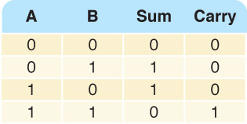
Half Adder
A circuit that computes the sum of two bits
Examine the half adder’s truth table carefully.
The Sum column has the same results as the XOR gate.
The Carry column has the same results as the AND gate.
Truth table

Slide 8
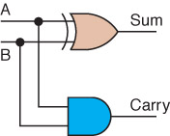
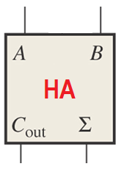
Half Adder
Logic symbol
Circuit diagram
Boolean expressions:
Sum = A ⊕ B Carry = AB

Slide 9
Binary Addition
Conceptually similar to decimal addition
(carry)
1
(carry)
1
(carry)
1
1 0 1 0
+ 1 1
1 1 0 1 0
+ 1 1 1 0 0
1
1
0
1
1
1
0
1
1
0

Slide 10
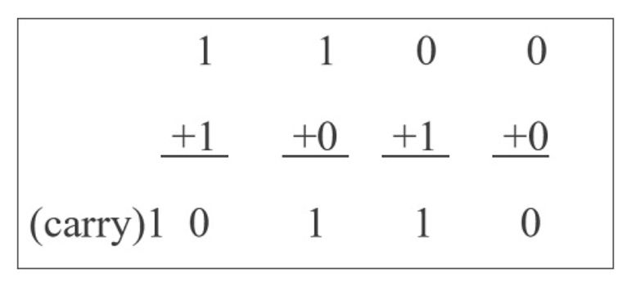

Slide 11
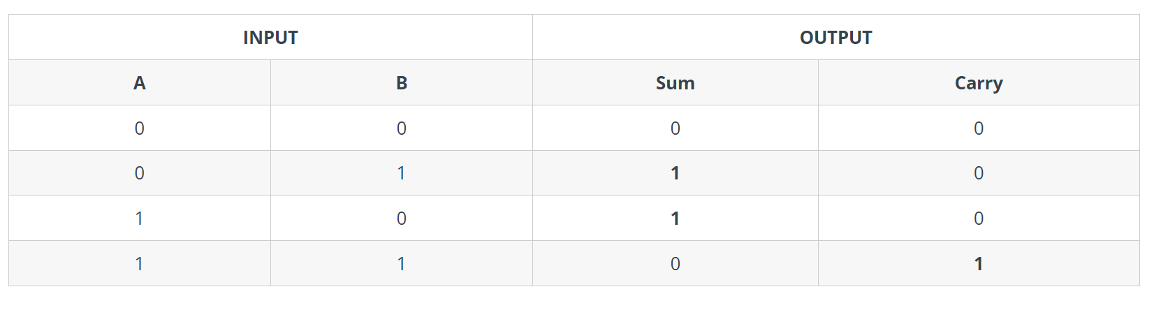

Slide 12
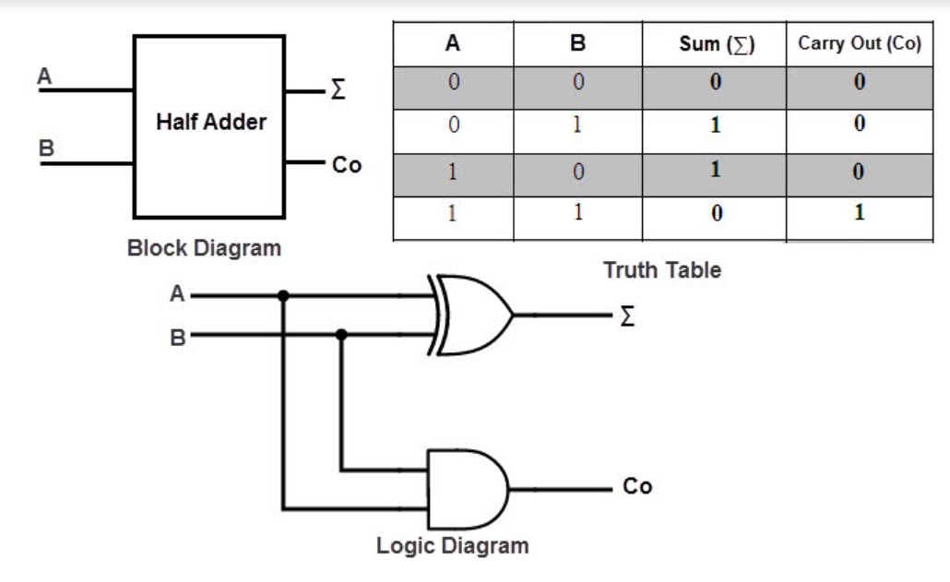

Slide 13
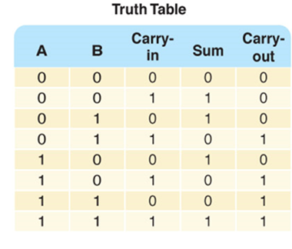
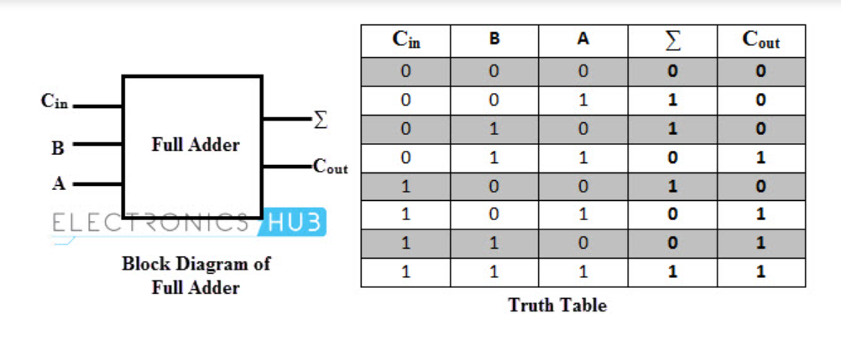
Full Adder
A circuit that takes the carry-in value into account

Slide 14
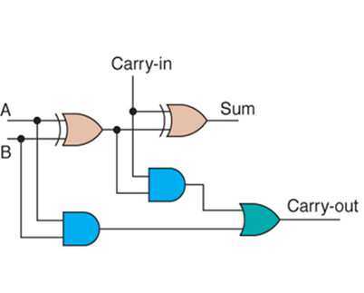
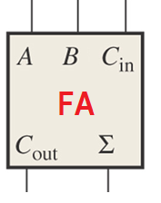
Full Adder
A circuit that takes the carry-in value into account
Logic symbol
Circuit diagram

Slide 15
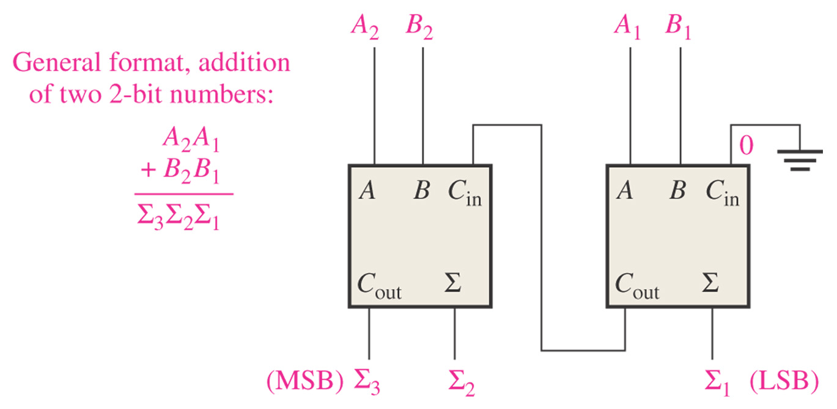
Parallel Binary Adder
Two or more full adders are connected to form parallel binary adders
2-bit parallel binary adder

Slide 16
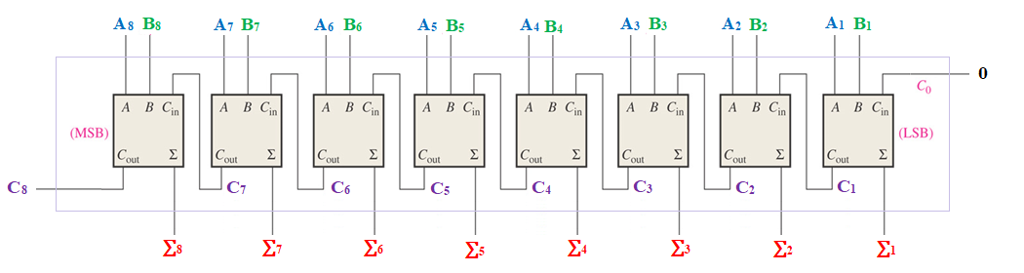
Parallel Binary Adder
0
A₈ A₇ A₆ A₅ A₄ A₃ A₂ A₁
B₈ B₇ B₆ B₅ B₄ B₃ B₂ B₁
_______________________
C₈ ∑₈ ∑₇ ∑₆ ∑₅ ∑₄ ∑₃ ∑₂ ∑₁
C₀
To add two 8-bit numbers (A + B), the carry input to the first stage should be 0 and the sum size will be 9-bit at most
+
Block diagram for 8-bit parallel binary adder

Slide 17
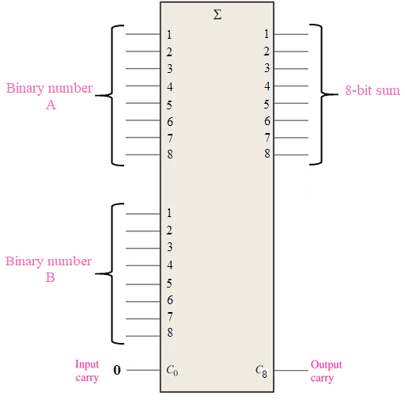
Parallel Binary Adder
8-bit parallel binary adder

Slide 18
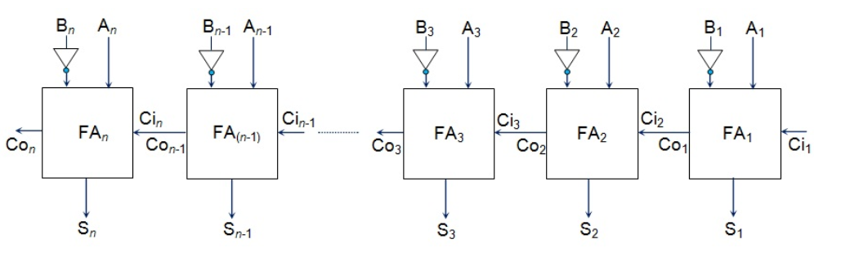
Parellel Substractor

Slide 19
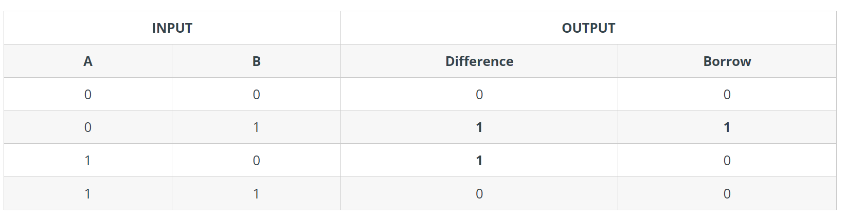
HALF SUBSTRACTOR TRUTH TABLE
Difference similar to XOR output
Borrow = NOR + AND

Slide 20
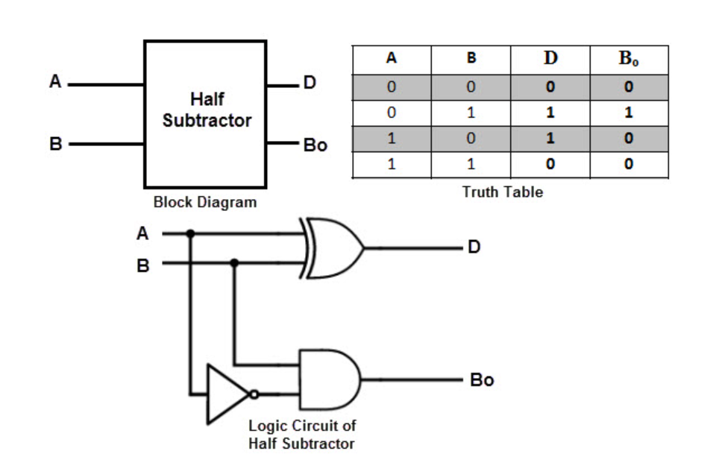

Slide 21
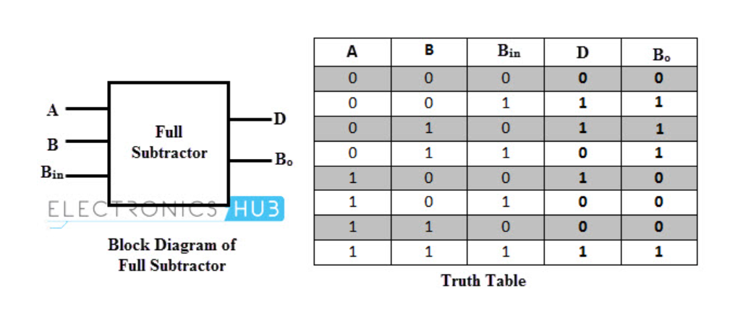
Full substractor

Slide 22
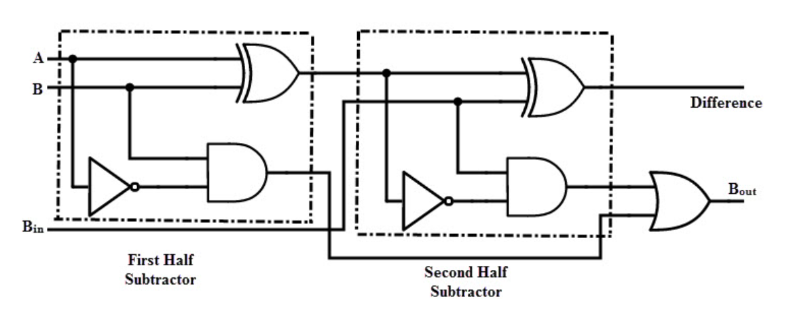

Slide 23
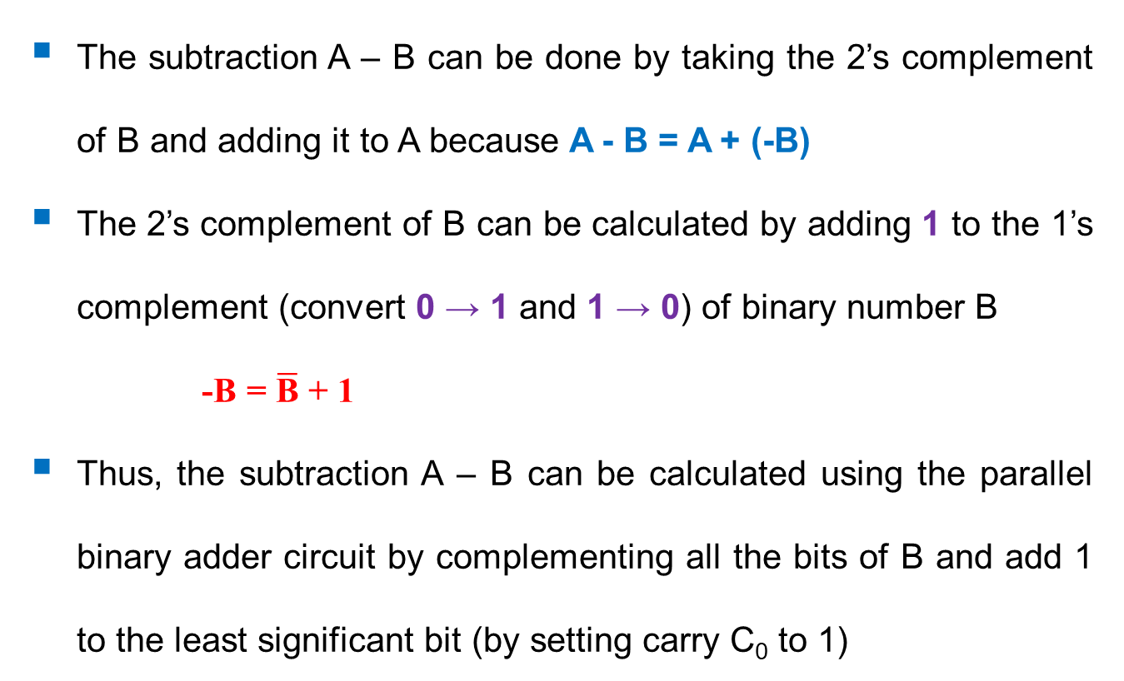
Parallel Binary Subtractor
The subtraction A – B can be done by taking the 2’s complement of B and adding it to A because A - B = A + (-B)
The 2’s complement of B can be calculated by adding 1 to the 1’s complement (convert 0 → 1 and 1 → 0) of binary number B
-B = $\overline{\text{B}}$ + 1
Thus, the subtraction A – B can be calculated using the parallel binary adder circuit by complementing all the bits of B and add 1 to the least significant bit (by setting carry C₀ to 1)

Slide 24
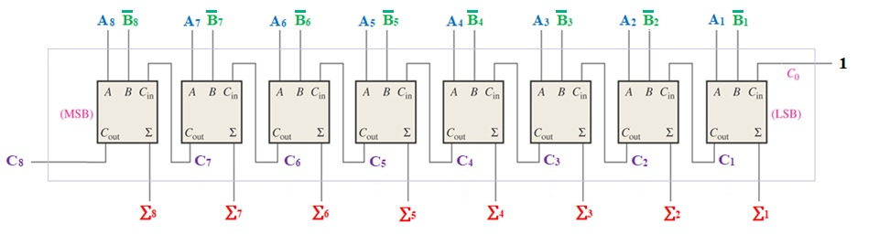
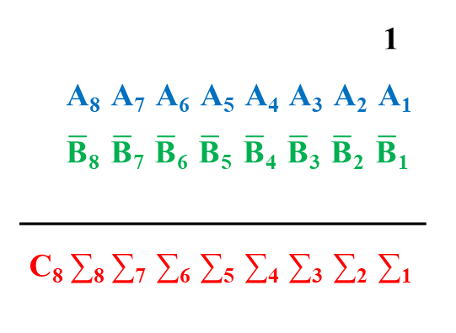
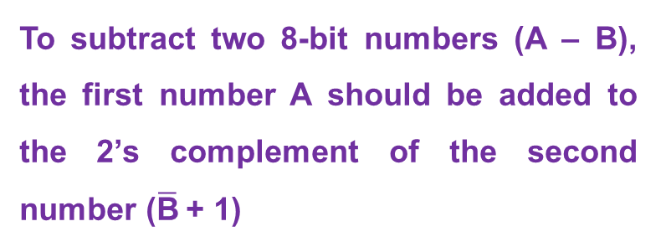
Parallel Binary Subtractor
1
A₈ A₇ A₆ A₅ A₄ A₃ A₂ A₁
$\overline{\text{B}}$₈ $\overline{\text{B}}$₇ $\overline{\text{B}}$₆ $\overline{\text{B}}$₅ $\overline{\text{B}}$₄ $\overline{\text{B}}$₃ $\overline{\text{B}}$₂ $\overline{\text{B}}$₁
_______________________
C₈ ∑₈ ∑₇ ∑₆ ∑₅ ∑₄ ∑₃ ∑₂ ∑₁
C₀
To subtract two 8-bit numbers (A – B), the first number A should be added to the 2’s complement of the second number ($\overline{\text{B}}$+ 1)
+
Block diagram for 8-bit parallel binary Subtractor

Slide 25
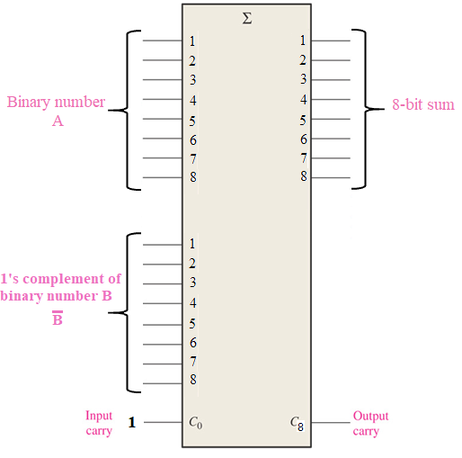
Parallel Binary Subtractor
8-bit parallel binary subtractor

Slide 26
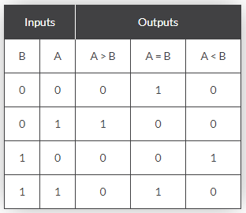
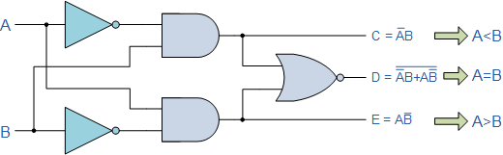
Comparator
Magnitude Comparator has three output terminals, one each for equality, A = B greater than, A > B and less than A < B.
1-bit Digital Comparator

Slide 27
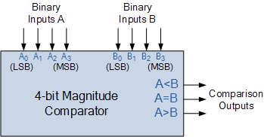
Comparator
4-bit Magnitude Comparator

Slide 28
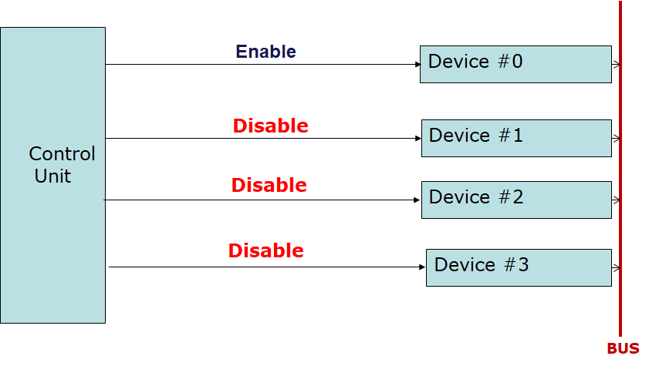
Decoder
If it is required to read or write data from 4 devices, only one device must be active at a time. To be able to control these 4 devices, each device should be connected to the Control Unit via an individual wire.
The more devices are connected, the more the number of wires!!

Slide 29
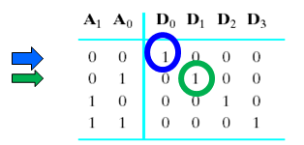
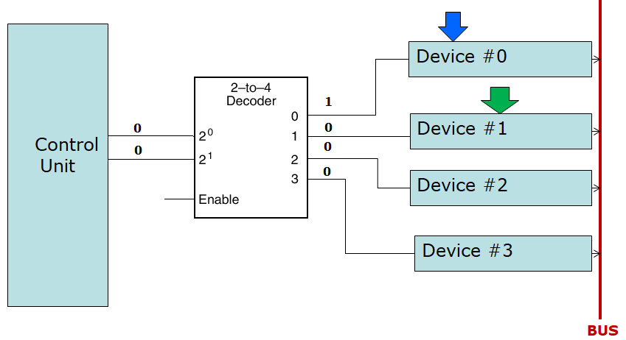
Decoder
Address decoding provides a solution to control the 4 devices using only 2 wires from my Control Unit.

Slide 30
Decoder
A decoder is a combinational digital circuit with a number of inputs n and a number of outputs 2^{n}.
Only one of the outputs is enabled at a time. The output enabled is the one specified by the binary number formed at the inputs of the decoder.
3-to-8 Decoder
Binary-to-Octal Decoder

Slide 31
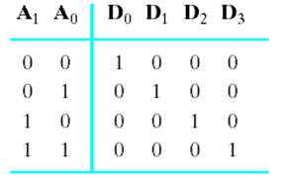
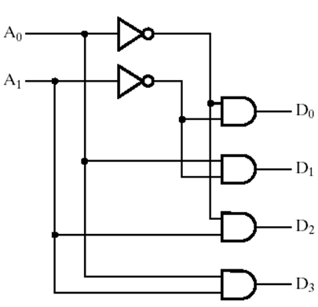
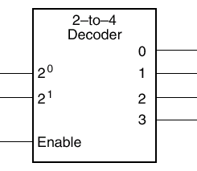
Decoder
2-to-4 Decoder

Slide 32
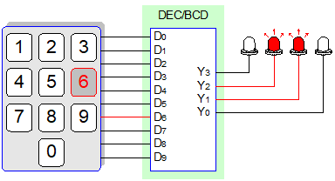
Encoder
The opposite of the decoding process.
An encoder has a number of input lines, only one of which is activated at a given time.
Take 2^{n} input lines and generate n output lines.
Decimal-to-BCD Encoder

Slide 33
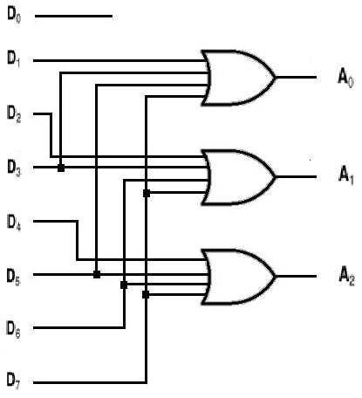
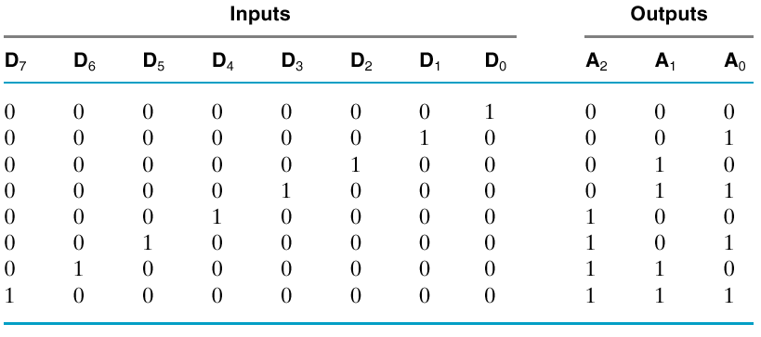
Encoder
Octal-to-Binary Encoder

Slide 34
Switching Network
Multiplexer (MUX)
Routes one of many inputs to a single output
Also called a selector
Demultiplexer (DEMUX)
Routes a single input to one of many outputs
Also called a distributer
Multiplexer
Demultiplexer
control
control

Slide 35
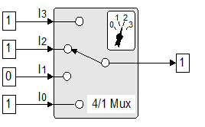
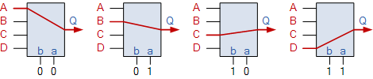
Multiplexers
A multiplexer (MUX) has 2^{n} data inputs, n control inputs and one output. The output has always the same value as the data input specified by the binary number at the control inputs.
A television producer wishes to select the output of one of three cameras to go to a monitor.
MUX is used to select which register from the CPU set of registers is connected to the ALU.
4-to-1 Multiplexer
Multiplexer Input Line Selection

Slide 36
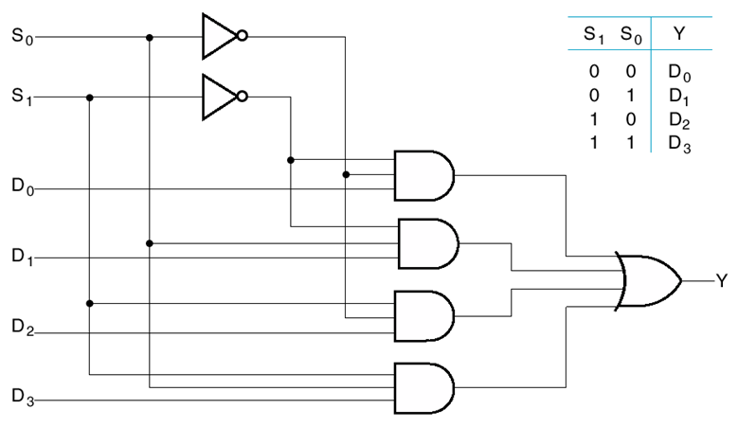
4-to-1 Multiplexer
4-to-1 Multiplexer

Slide 37
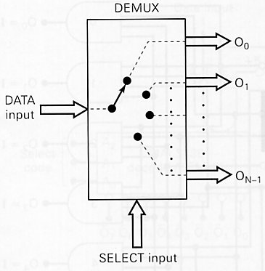
Demultiplexer
A demultiplexer (DEMUX) has a single input and distributes it over has 2^{n} outputs using n control inputs.

Slide 38
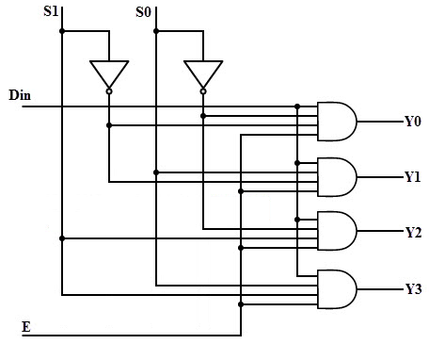
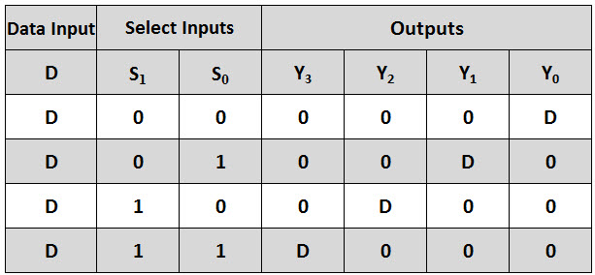
Demultiplexer
1-to-4 Demultiplexer

Slide 39
MUX/DEMUX Applications
Sharing complex logic functions such as sharing an adder: MUX select inputs and DEMUX distribute the sum
A₀ A₁
B₀ B₁
S_{a}
MUX
MUX
S_{b}
multiple inputs
A
B
single adder
Sum
S_{s}
DEMUX
multiple output destinations
Z₀ Z₁

Slide 40

Sequential Circuits

Slide 41
Sequential Circuits
Digital circuits can also be used to store information.
This application employs sequential circuits, because the output of the circuit is also used as input to the circuit. These circuits are the basic form for designing memory.

Slide 42
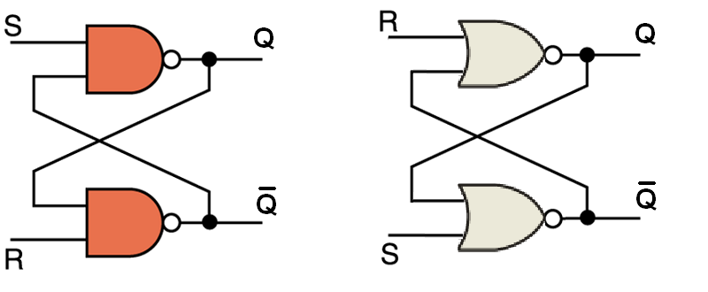
Circuits as Memory
NAND Active-LOW Latch NOR Active-HIGH Latch
The S-R (Set-Reset) latch is the most basic type. It can be constructed from NOR gates or NAND gates.

Slide 43
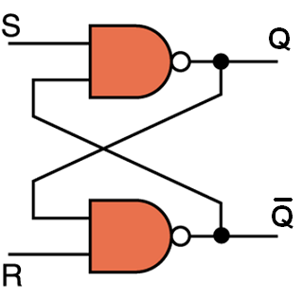
SR Latch
An S-R latch stores a single binary digit (1 or 0)
There are several ways an S-R latch circuit can be designed using various kinds of gates

Slide 44
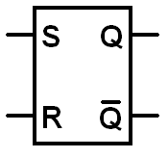
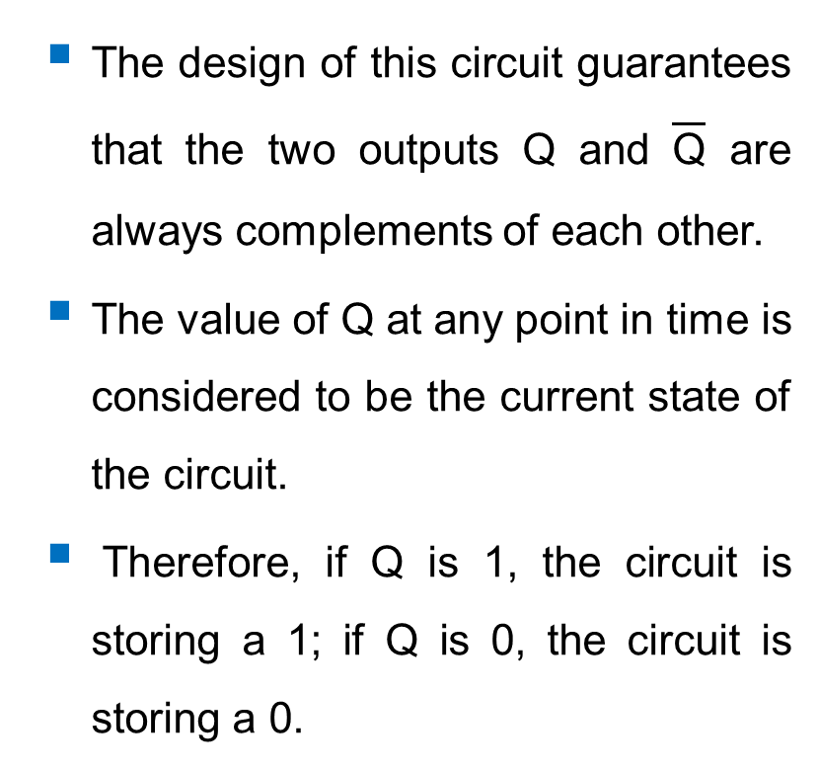
SR Latch
The design of this circuit guarantees that the two outputs Q and $\overline{\text{Q}}$ are always complements of each other.
The value of Q at any point in time is considered to be the current state of the circuit.
Therefore, if Q is 1, the circuit is storing a 1; if Q is 0, the circuit is storing a 0.

Slide 45
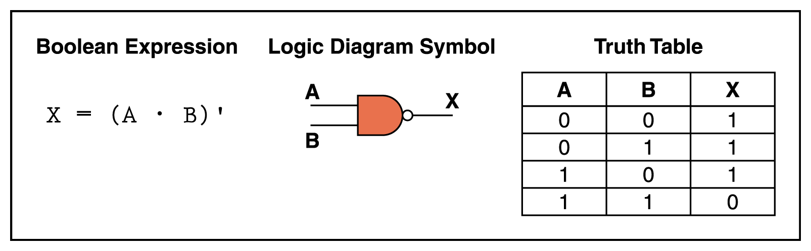
NAND Gate Recap
The NAND gate accepts more than one input signal. If all inputs are 1, the output is 0; otherwise, the output is 1

Slide 46
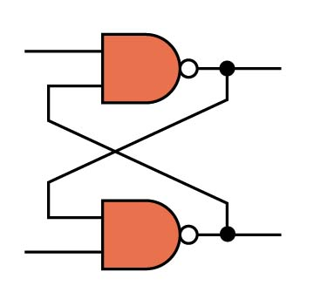

SR Latch
If R=0 and S=1
The latch is Reset (Q = 0)
S=1
Q
=0
1
$$\overline{\text{Q}}$$
=1
R=0

Slide 47
SR Latch
If R=1 and S=0
The latch is Set (Q = 1)
S=0
Q
=1
1
$$\overline{\text{Q}}$$
=0
R=1

Slide 48
SR Latch
If R=1 and S=1
S=1
1 at one of the inputs does not guarantee the value of output. So, the second input has to be tested.
Q
=1
1
If Q=1
0
The latch stores the old value of Q (Q=1)
$$\overline{\text{Q}}$$
=0
R=1

Slide 49
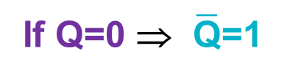
SR Latch
If R=1 and S=1
S=1
1 at one of the inputs does not guarantee the value of output. So, the second input has to be tested.
Q
=0
0
If Q=0 ⇒ $\overline{\text{Q}}$=1
1
The latch stores the old value of Q (Q=0)
$$\overline{\text{Q}}$$
=1
R=1

Slide 50
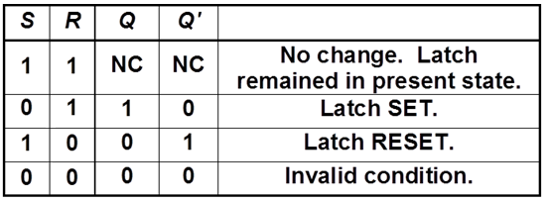
SR Latch
Truth Table

Slide 51
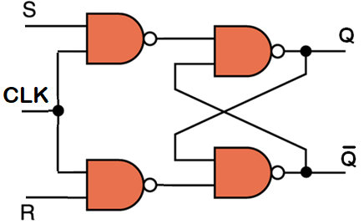


Gated SR Latch
The S and R inputs are only enabled (i.e. affect the circuit) when the clock input is 1. When the clock input is 0, it stores the previous state.

Slide 52



D-Type Latch
It ensures that inputs S and R are never equal to 1 at the same time

Slide 53

4-bit Register

Slide 54

4-bit Shift Register
Serial in – Parallel out Shift Register

Slide 55
Further Reading
Computer Organization and Architecture – Designing for Performance (10th Edition), William Stallings [Chapters: 11]
Digital Fundamentals (11th Edition), Thomas L. Floyd [Chapters: 6, 7, 8, 9]
Computer Organization and Design – The Hardware/Software Interface (5th Edition), David A. Patterson & John L. Hennessy [Appendix: A]
Fundamentals of Computer Architecture, Mark Burrell [Chapter: 4, 5]

